Slide 1

Capstone Project[E1CSH25707]
Alliance School of Advanced Computing
Project Title: Civil Status Certificate Management System
Batch : 2025 - 2027
Presented by
NEGUE KWAHAM MAEL GRACE
2511022120042
Name of the Mentor: Dr. RAJESH E.
Date of Review :

Slide 2

Outline
Problem Statement and Motivation
Research Objectives
Proposed Methodology
System Modelling
Dataset / Experimental Setup
Implementation Status
Experimental Results
Results and Discussion
Conclusion and Future Work

Slide 3

I. Problem Statement and Motivation
In Cameroon, civil status certificates such as birth, death, and marriage certificates are primarily managed through local municipal archives. Citizens who relocate to another region often face difficulties accessing their certificates because they must return to the municipality where the record was originally registered. The reliance on physical archives also causes delays in searching, verifying, and retrieving civil records.
The proposed system addresses the need for accessible, efficient, and secure civil registry services in Cameroon. By digitizing record management and enabling requests through nearby municipalities, the system aims to reduce administrative delays, improve service accessibility, and support the modernization of civil registry operations.

Slide 4

II. Research Objectives
The primary objective is to design and develop a secure, centralized web-based Civil Status Certificate Management System that improves access to birth, death, and marriage certificates across Cameroon.
The specific objectives include:
Develop a responsive web application for citizens and administrators.
Implement secure authentication with multi-factor authentication (MFA).
Enable citizens to search and request civil status certificates.
Digitize and organize civil records for efficient retrieval.
Implement location-based routing to nearby municipal councils.
Develop administrative interfaces for verifying and processing requests.
Implement security, audit logging, and data integrity mechanisms.
Establish a scalable architecture for future system expansion.

Slide 5

III. Proposed Methodology
The system will adopt a layered architecture consisting of a frontend, backend, database, and supporting services. The frontend will use Next.js, TypeScript, and Tailwind CSS, while the backend will use Express.js. PostgreSQL will manage civil records and geographical information, supported by authentication, notification, and document storage services.

Slide 6
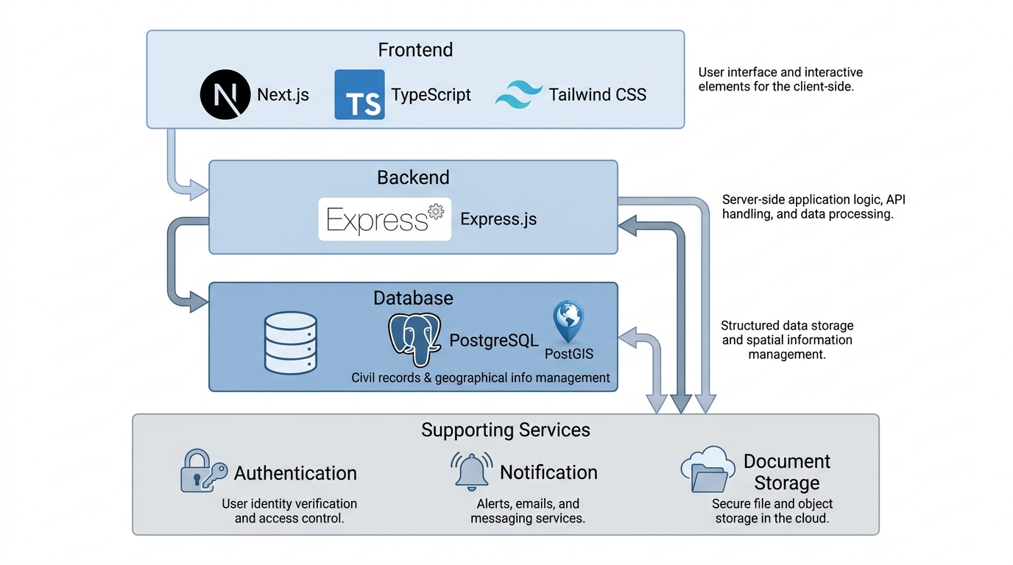

Slide 7
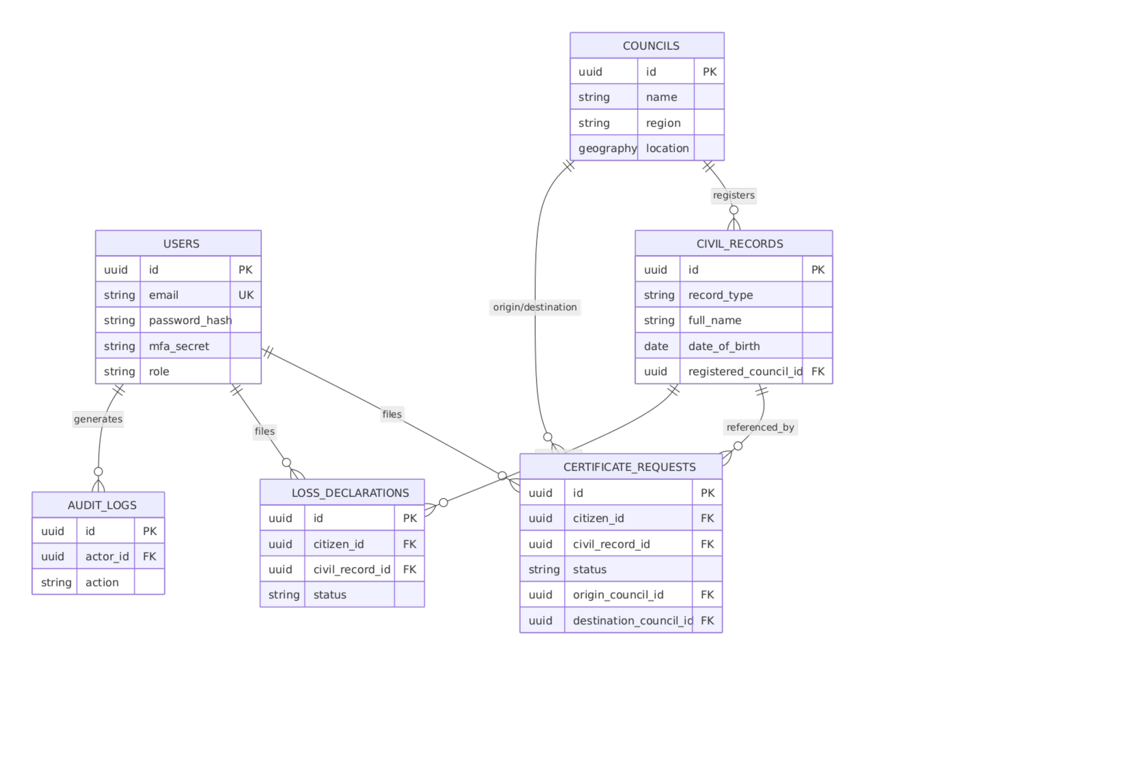
VI. System Modelling: ER Diagram

Slide 8
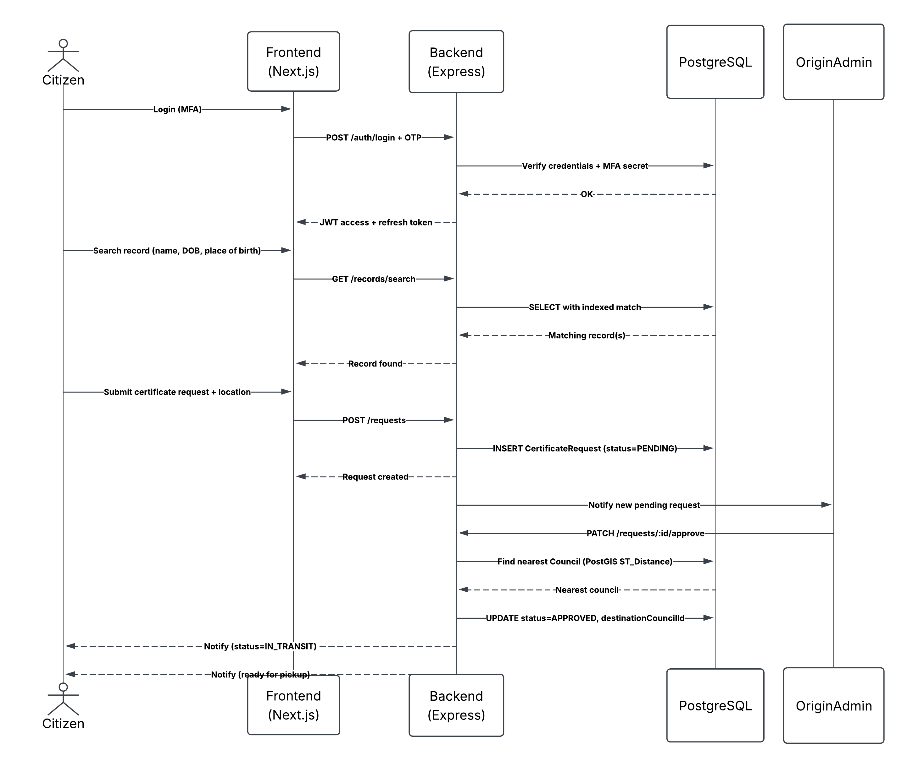
Sequence Diagram

Slide 9
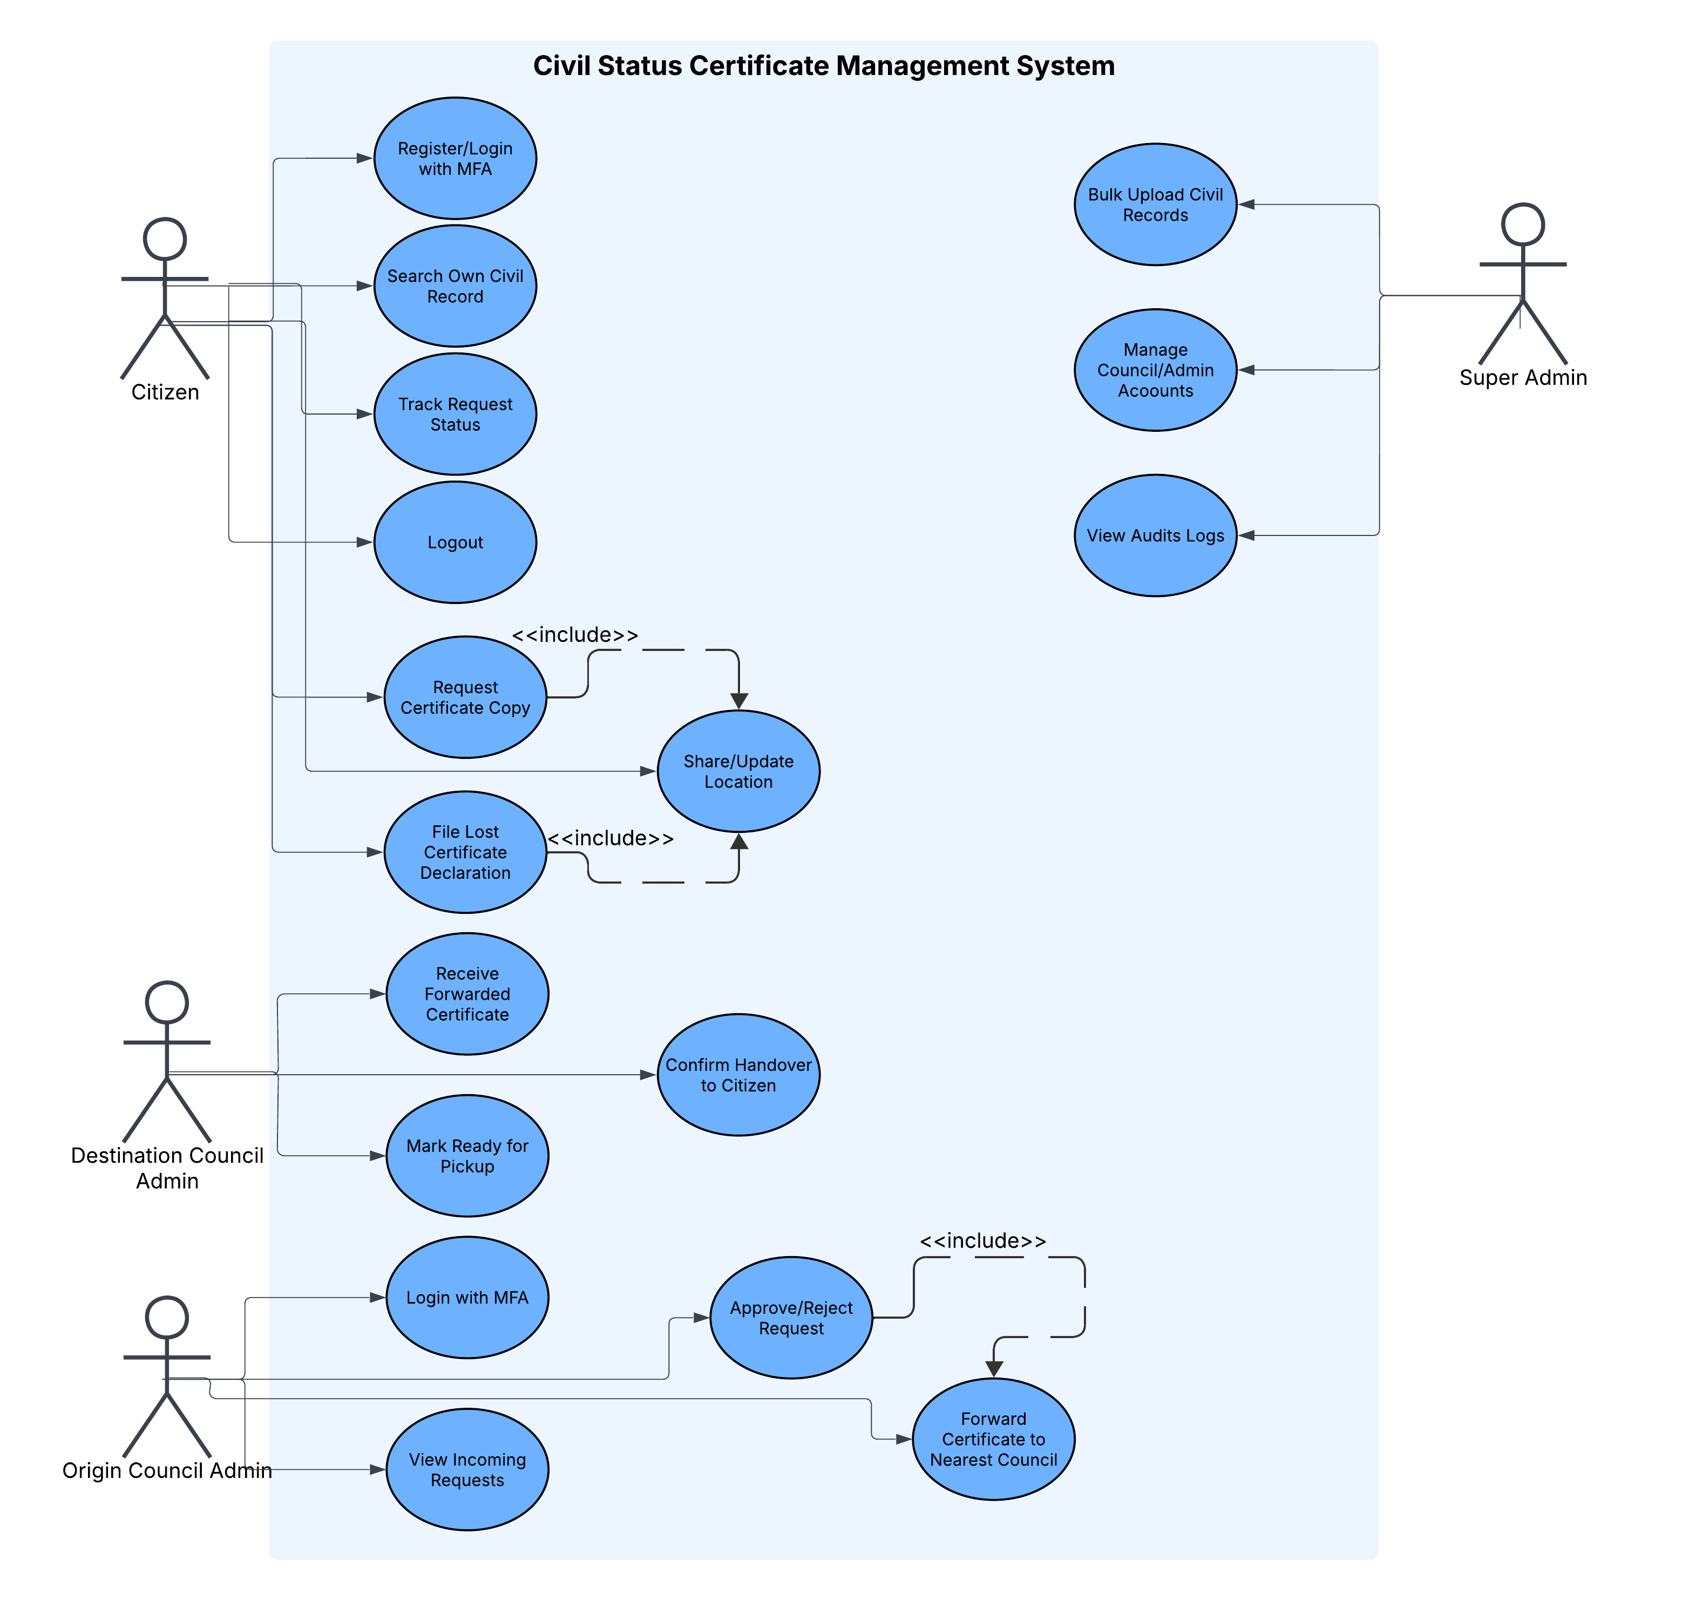
Use-case Diagram

Slide 10
V. Dataset / Experimental Setup
Dataset Description and Source
Data Collection / Preprocessing
Experimental Environment
Training, Testing and Validation Strategy
Evaluation Metrics

Slide 11
VI. Training, Testing and Validation Strategy
Testing Strategy
Unit Testing: Test individual backend services and functions.
Integration Testing: Verify frontend, backend, and database communication.
API Testing: Validate request processing and authentication.
Security Testing: Test authorization, MFA, and input validation.
Usability Testing: Evaluate citizen and administrator interfaces.
Performance Testing: Measure record search and request processing times.
User Acceptance Testing: Validate workflows with representative users.
Validation: Verify that requests are correctly processed, routed, and tracked.

Slide 12
VII. Implementation Status
Project Component | Status
Problem Identification | Completed
Requirements Analysis | Completed
System Modelling | Completed
Architecture Design | Completed
Database Design | Completed
Frontend Implementation | Completed
Backend Implementation | Completed
Database Implementation | Completed
Testing | Pending
Deployment | Pending

Slide 13
VIII. Results and Discussion
Interpretation of Results
Analysis of Key Findings
Validation of Research Objectives
Strengths and Limitations

Slide 14
IX. Conclusion and Future Work
Interpretation of Results
Analysis of Key Findings
Validation of Research Objectives
Strengths and Limitations

Slide 15













Department of Computer Science and Engineering Alliance School of Advanced Computing
THANK YOU
Presented by
Name of the Presenter

